Slide 1
Git Basics Training
Hands-on Workshop on the Fundamental concepts of Git version control and Github
Faye Nielsen, Mario Krapp, Jack Drummond, Quyen Nguyen

Slide 2
Agenda
Intro & Key Concepts
Git (local) Fundamentals
GitHub and Collaboration
Discussion & Wrap up

Slide 3
What is Git and Github?
Git is known as a version control system
Version control is a system that records changes to a file or set of files over time so that you can recall specific versions later.
Github is an online platform to store files in the cloud which enables backed up storage, sharing/collaborating with others, easy integration with other cloud softwares

Slide 4
Why is Git useful?
Git is like a time machine for your code that creates snapshots of your work, letting you easily revert to previous versions and experiment safely.
Example: You're analysing earthquake data with analyse_data.py. You add a new visualisation function, but it breaks your entire analysis. What changed?
Without Git: analyse_data_v1.py, analyse_data_v2_final.py etc.
With Git: One file. Instant revert to the last working version with a single command. Essential when working with complex research code or collaborating with others.

Slide 5
How does it work?
Essentially, Git is a turbocharged save button.
A save in Git is called a commit. When you make a commit, you take a snapshot of all the files you have made visible to git – otherwise known as your git repository, or repo for short.
This snapshot saves everything in it’s current state, and that particular commit can then be accessed further down the line if you mess anything up.

Slide 6
Key Concepts / Commands

Slide 7
Repository (repo for short)
A folder/directory that is tracked by git (i.e. it has a .git folder)

Slide 8
Repository (repo for short)
A folder/directory that is tracked by git (i.e. it has a .git folder)
A local repository is on your local machine e.g. laptop, PC
A remote repository is hosted on a server e.g. Github, Gitlab

Slide 9
The Three States / Areas

Slide 10

The Three States / Areas
Working directory
Where you edit files and do your work

Slide 11

The Three States / Areas
Working directory
Where you edit files and do your work
Git Repository
Files saved to and tracked by Git

Slide 12
The Three States / Areas
Working directory
Where you edits files and do your work
Git Repository
Files saved to and tracked by Git
Staging area
Where files are prepared for saving to Git

Slide 13

The Three States / Areas
Working directory
Where you edits files and do your work
Staging area
Where files are prepared for saving to Git
Git Repository
Files saved to and tracked by Git
Git add

Slide 14
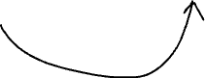
The Three States / Areas
Working directory
Where you edits files and do your work
Staging area
Where files are prepared for saving to Git
Git Repository
Files saved to and tracked by Git
Git add
Git commit

Slide 15

Add
‘Stage’ files
Prepare files to track in Git by selecting which ones you want to save
This is useful as you might only want to save one file, and leave the others out as they are not needed

Slide 16
Commit
Snapshot of all files at that moment in time, including the changes you ‘staged’ by using the ‘add’ command
These are the building blocks of your version control history, when you look back through them you will see what changed between one commit and the next
Has a unique ID, message, author and timestamp

Slide 17
Branch
Parallel version of a project
Enables you to work on different features on different branches, rather than everything all together where it can get confusing
Enables multiple people to work on the same codebase without disrupting/breaking what someone else is working on
Gets merged back into the ‘main’ branch

Slide 18
Merge
Merging branches back into the ‘main’ branch
The main branch is the source of truth. For example, if you have a software product, what is live in the product will be what is on the main branch.
When changes on a branch are finished, they can be merged into main and be made ‘official’

Slide 19
Set up First Repository

Slide 20
Step 1: Configure identity
You only ever need to do this once
git config --global user.name "Your Name"
git config --global user.email "your.email@example.com"
Check it worked:
git config --global --list

Slide 21
Step 2: Create first repository
I recommend creating a folder called repositories in your home folder
cd ~ cd C:\Users\yourUserName
mkdir repositories
cd repositories
mkdir my-first-project
ls dir
cd my-first-project
git init

Slide 22
Step 2: Create first repository
I recommend creating a folder called repositories in your home folder
Check for hidden .git file:
ls –la dir /a
Check what git can currently see:
git status

Slide 23
Step 3: Create first file
1. Create a README.md file with your text editor:
echo # My Git Project > README.md
2. Check the file exists:
ls dir
3. Look at the contents on the file:
more README.md less README.md cat README.md
4. Exit:
q

Slide 24
Step 4: First commit
1. Check what Git sees:
git status
2. Stage the file (prepare it for commit):
git add README.md
git status
3. Make your first commit (save the snapshot):
git commit -m "Initial commit: Add README”
git status

Slide 25
Step 4: First commit
You want to use descriptive messages in each commit.
It is really easy to forget what or why you made a commit, and even harder for other people if you are collaborating.

Slide 26
Step 3: View History
git log

Slide 27
The Git Workflow

Slide 28
The Git Workflow
Edit -> Check -> Add -> Commit -> Repeat

Slide 29
Step 1: Single file change
Edit README.md, add these lines:
I am learning about version control
2. Check what changed:
git status
3. See the actual changes:
git diff
4. Stage and commit:
git add README.md
git commit -m "Add learning section to README"
5. Check the log:
git log --oneline

Slide 30
Step 2: Multiple file change
Create a python file called ‘test.py’:
print(“hello, world!”)
echo 'print('hello, world!')' > test.py
2. Edit README.md:
# My Progress
Learning git basics
Echo ‘# My Progress\nLearning git basics’ >> README.md

Slide 31
Step 2: Multiple file change
3. Check status:
git status
4. Stage only README.md:
git add README.md
git status
5. Unstage it:
git restore --staged README.md
git status

Slide 32
Step 2: Multiple file change
6. Add all changes at once:
git add -A
git status
Stages everything: new files, modified files, deleted files
7. Commit everything together:
git commit -m "Add test.py and update README with progress”
8. View your history:
git log --oneline

Slide 33
Quick Practice of the workflow
Challenge: On your own, try one more cycle:
Make any change to any file, create a new one, or delete one
Use git status to see it
Use git add -A to stage everything
Commit with a descriptive message

Slide 34
Fixing Common Mistakes

Slide 35
Scenario 1: Added the wrong file
1. Create a temporary file:
echo "temporary stuff" > temp.txt
Windows Command Prompt: echo temporary stuff > temp.txt
2. Oops, add it by mistake:
git add temp.txt
git status
Point out: It is green and ready to be committed
3. Unstage it:
git restore --staged temp.txt
git status
Point out: Back to red (unstaged)

Slide 36
Scenario 2: I want to undo my changes
Edit test.py but don't commit :
Print(“1+1 = 3”)
2. Check you have uncommitted changes:
git status
git diff
3. Discard the changes:
git restore test.py
git status
File is back to how it was at last commit

Slide 37
Scenario 3: Committed too early
1. Make a small change to notes.txt and commit:
echo "- git restore" >> notes.txt
git add notes.txt
git commit -m "Update notes"
Windows Command Prompt: echo - git restore >> notes.txt
2. Oops! You realize you wanted to add more. Let's undo that commit but keep the changes:
git reset --soft HEAD~1
Explain:
HEAD~1 means "one commit before current"
--soft keeps your changes staged (green)
The commit disappears but your work is safe
3. Check status:
git status
Point out: Your changes are still there, staged and ready
4. Now you can add more changes and commit them together:
echo "- git reset" >> notes.txt
git add notes.txt
git commit -m "Update notes with restore and reset commands"
Windows Command Prompt: echo - git reset >> notes.txt
5. Check the log:
git log --oneline
Point out: Just one commit with everything together

Slide 38
Scenario 4: Committed the wrong thing
1. Let's create a mistake on purpose - add a file we don't want:
echo "This is a mistake" > mistake.txt
git add mistake.txt
git commit -m "Add mistake file (oops!)"
2. View log:
git log --oneline
Point out: There's our mistake commit
3. Undo the commit completely:
git reset HEAD~1
Explain:
No --soft this time (default is --mixed)
Changes are kept but unstaged (red)
More common than --soft
4. Check status:
git status
Point out: mistake.txt is there but unstaged
5. We don't want this file at all, so discard it:
git restore mistake.txt
6. Verify it's gone:
git status
git log --oneline

Slide 39
Instructions for use
This master template includes a range of slide layouts and design options. Please use the ones that best suit your presentation and delete any unused slides.
The logo slides at the beginning are intended as holding pages for conferences and events.
If you plan to print this presentation, please ensure font embedding is enabled to preserve typography and layout consistency.
To embed fonts:
Windows (PC): Go to File → Options → Save → Embed fonts in the file, then select Embed all characters.
Mac: Go to PowerPoint → Preferences → Save, then tick Embed fonts in the file.

Slide 42
Welcome to Earth Sciences New Zealand

Slide 43
Welcome to Earth Sciences New Zealand
On July 1, 2025 NIWA and GNS Science merged to become a new Public Research Organisation called Earth Sciences New Zealand

Slide 49
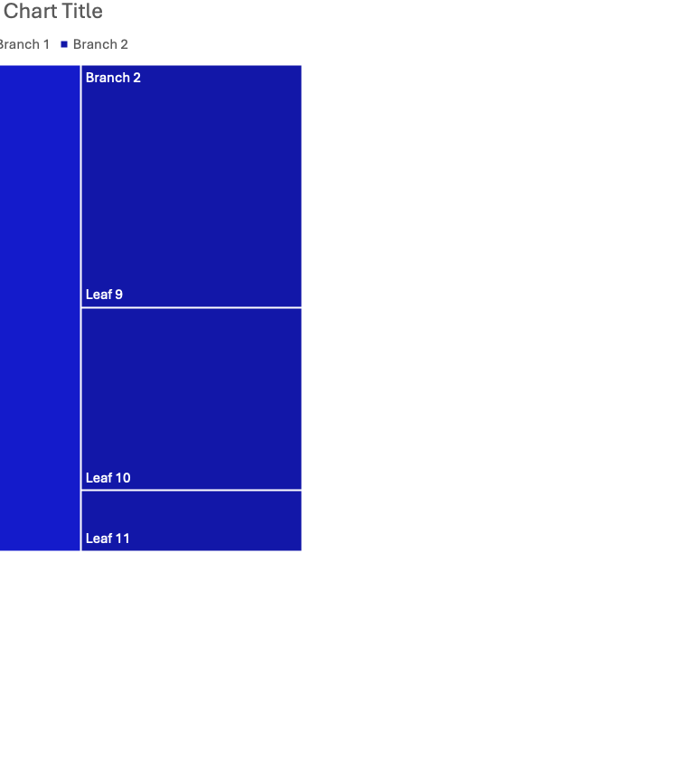

Slide 51
Heading

